Slide 1
DEVICE MANAGEMENT

Slide 2
Magnetic disks
Provide the bulk of secondary storage for modern computer systems.
Consist of several disk platters which have a flat circular shape.
Platter surfaces covered with a magnetic material.
Information recorded magnetically on the platters.

Slide 3
Each platter surface is divided into circular tracks which are subdivided into sectors.
Set of tracks at one arm position form a cylinder.
A read-write head flies just above each surface of every platter.

Slide 4
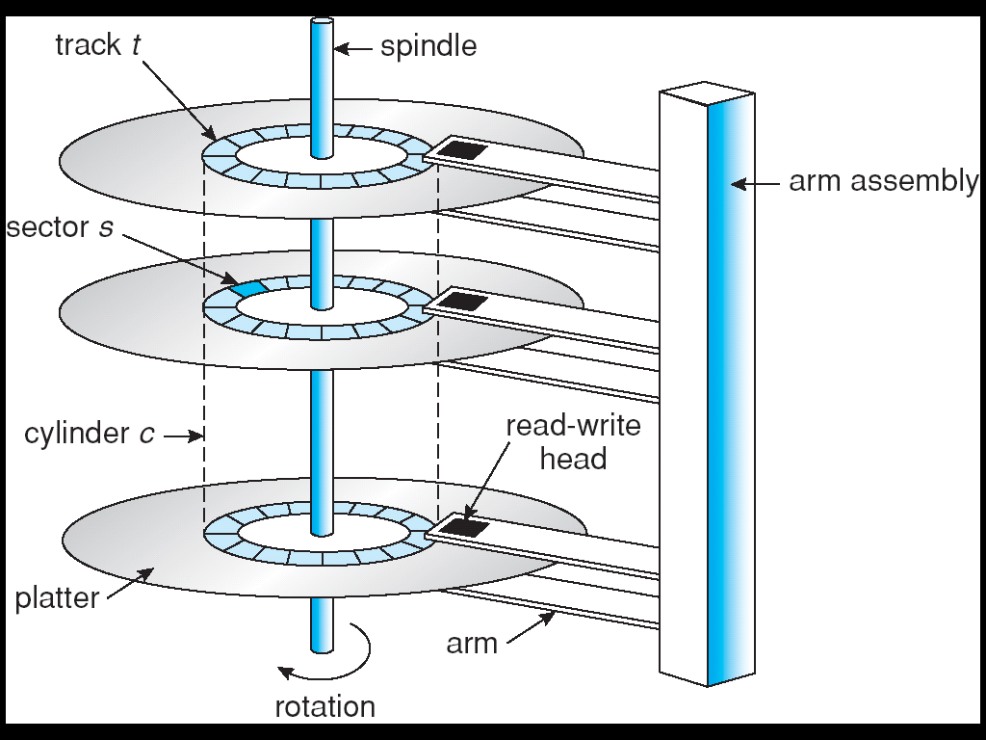
Moving-head disk mechanism

Slide 5
A drive motor spins the disk at a high speed (60 to 150 times per second).
Two parts of disk speed –
transfer rate – rate at which data flows between the drive and the computer.
positioning time (random access time) –
Seek time – time to move the disk arm to the desired cylinder.
Rotational latency – time for the desired sector to rotate to the disk head.

Slide 6
Head crash – if the disk head comes in contact with the disk surface, it can damage the surface.
Cannot be repaired, disk needs to be replaced.

Slide 7
Disk Scheduling
Operating system needs to use the hardware efficiently.
In case of disk drives, fast access time and disk bandwidth.
Disk bandwidth – total number of bytes transferred divided by the total time between the first request for service and the completion of the last transfer.

Slide 8
Disk Scheduling Algorithms
First-come, first-served (FCFS) Scheduling –
A disk queue with requests for I/O to blocks on cylinders
98, 183, 37, 122, 14, 124, 65, 67
Disk head is initially at cylinder 53.
Total head movement of 640 cylinders.

Slide 9
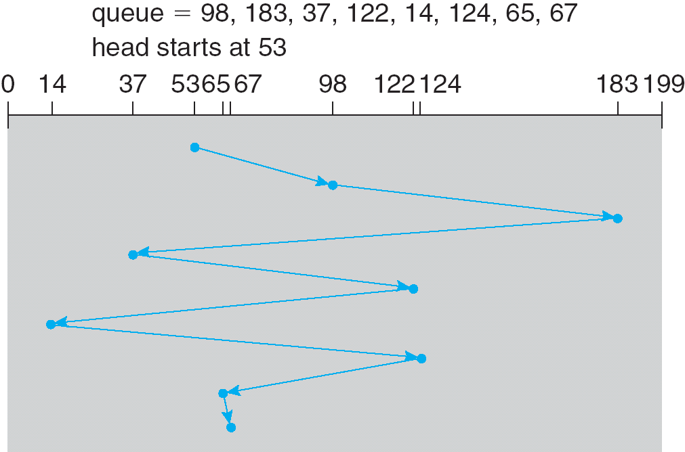
FCFS disk scheduling

Slide 10
2. Shortest-seek-time-first (SSTF) scheduling -
Selects the request with the minimum seek time from the current head position.
May cause starvation of some requests.
Significantly better than FCFS but not optimal.

Slide 11
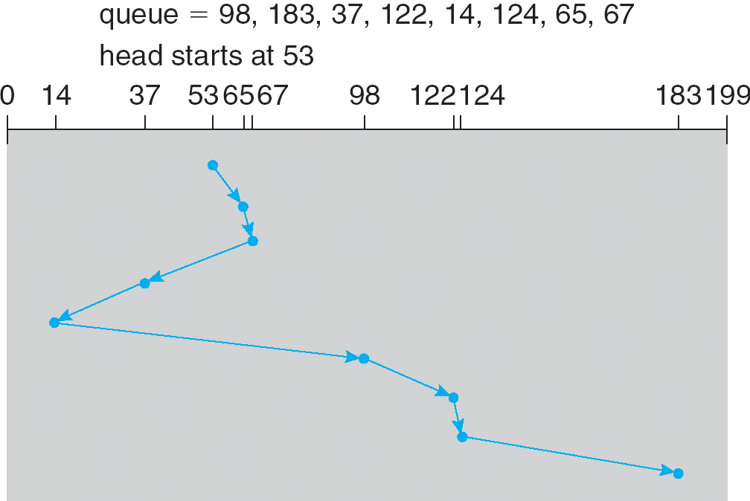
SSTF Scheduling

Slide 12
3. SCAN Scheduling/elevator algorithm
The disk arm starts at one end of the disk and moves toward the other end servicing requests until it gets to the other end of the disk where the direction of head movement is reversed and servicing continues.
Direction of head movement plus head’s current position.

Slide 13
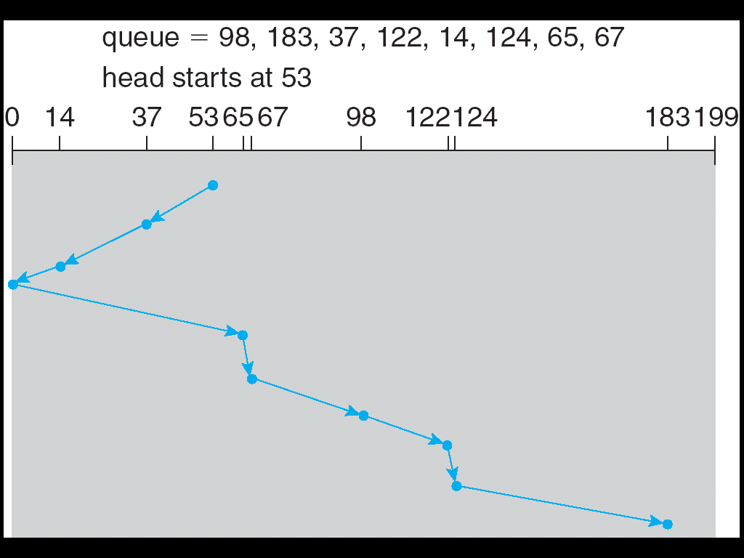
SCAN Scheduling

Slide 14
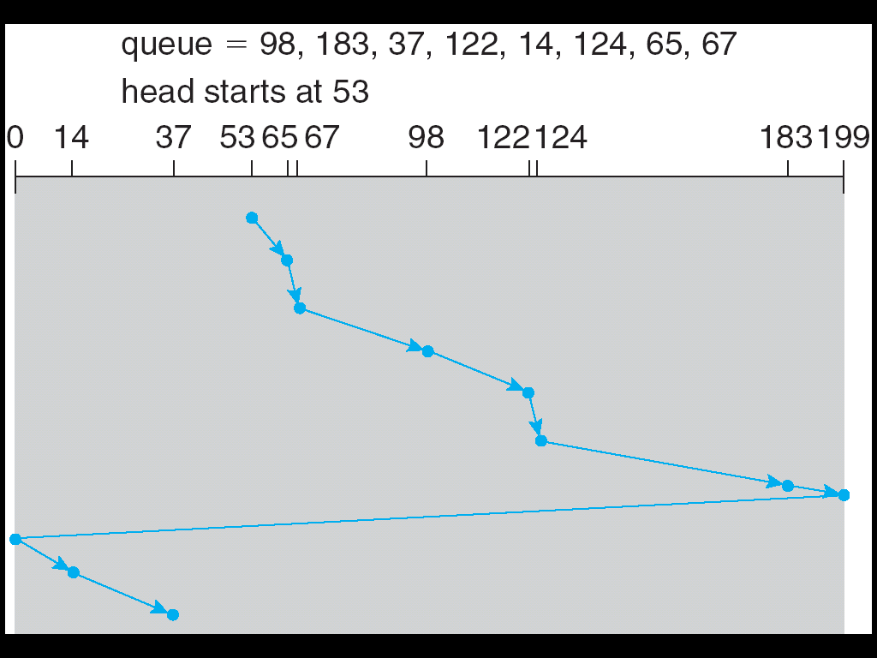
4. C-SCAN Scheduling -
Provides a more uniform wait time.

Slide 15
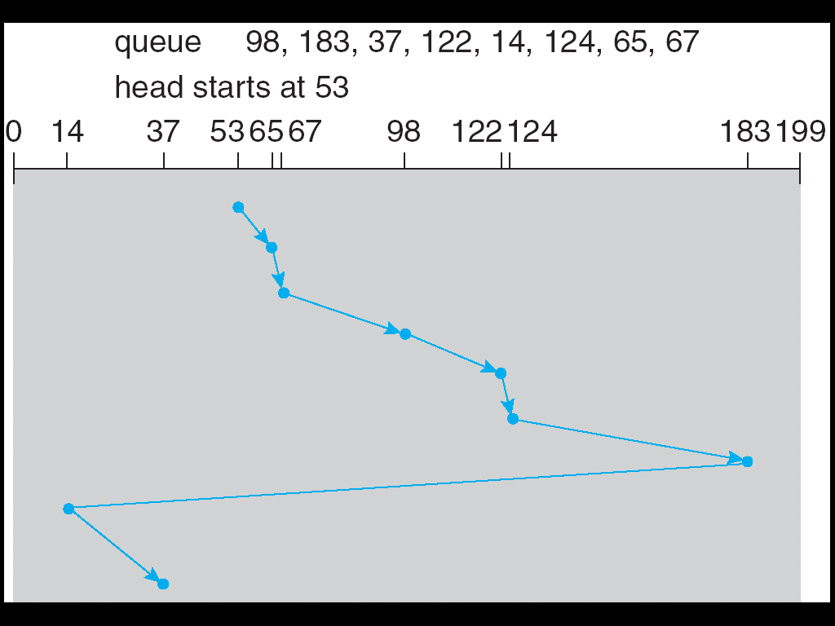
5. LOOK Scheduling
6. C-LOOK Scheduling

